Slide 1
19Z601- MACHINE LEARNING
UNIT- 1 INTRODUCTION
Presented by
Ms.Anisha.C.D
Assistant Professor
CSE

Slide 2
The problem of transforming raw data into dataset is called feature engineering.
One Hot Encoding | Transformation of categorical feature into several binary codes is called One Hot Encoding . Example : Categorical Feature “Colors” with three possible values : Red, Yellow and Green, Transform this feature into a vector of three numerical values. Red = [1,0,0] Yellow = [0,1,0] Green = [0,0,1]
Binning | Transformation of numerical feature into categorical one. Binning is also called bucketing is the process of converting a continuous feature into multiple binary features called bines or buckets.
Normalization | Process of converting an actual range of values which a numerical feature can take into a standard range of values, typically in the interval [-1,1] or [0,1]
Standardization | Z-score Normalization (Standardization) is the procedure during which the feature values are rescaled so that they have the properties of a standard normal distribution with mean = 0 and standard deviation =1 .
RECAP – TRANSFORMATION

Slide 3
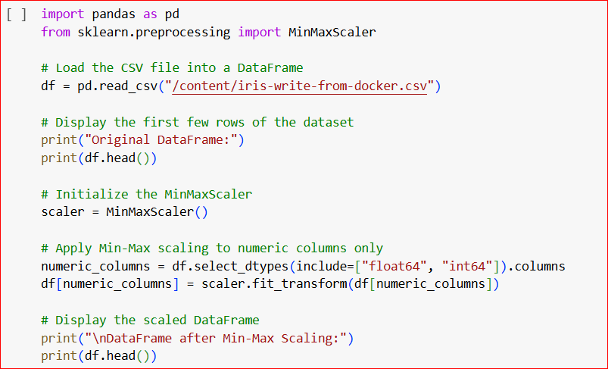
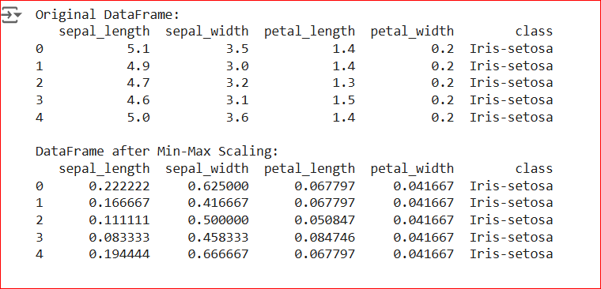

Min Max Normalization
What is the Mathematics behind Min Max Normalization?
$X_{Scaled}$ = $\frac{X − X_{min} }{\max{−min}}$ * (new max –new min) + new min

Slide 4
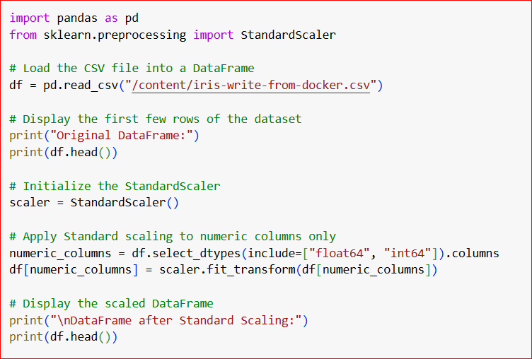
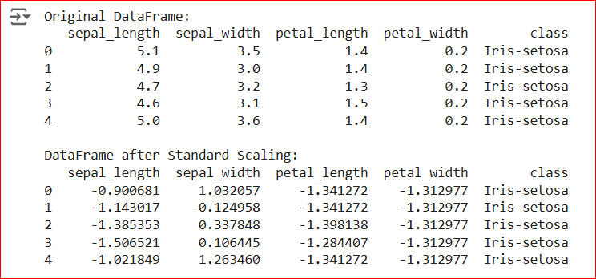
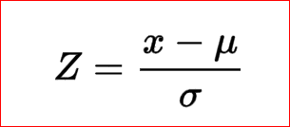
Z Score Normalization (Standardization)
What is the Mathematics behind Standardization?
Mean
Standard Deviation

Slide 5
DIMENSIONALITY REDUCTION
There are two methods for dimensionality reduction :
METHODS | DESCRIPTION
Feature Selection | Finding K of the d dimension which gives more information and discard (d-k) dimension. Example : Subset Feature Selection
Feature Extraction | Finding new set of k dimensions which is a combination of original d dimensions. Examples : Linear Projection Methods : Principal Component Analysis (PCA) – Unsupervised Learning Linear Discriminant Analysis – Supervised Learning

Slide 6
Principal Component Analysis
Step 1 : Standardization
Step 2 : Co-variance Matrix Computation
Step 3 : Computation of Eigen vectors and Eigen Values of the Covariance matrix to identify the Principal Components.
Step 4 : Create a Feature Vector
Step 5 : Recast the data along the Principal Components Axes

